Slide 1
Windows Form
Presented By :Er.Sudan Prajapati

Slide 2
Open File Dialog Box
The OpenFileDialog component allows users to browse the folders of their computer or any computer on the network and select one or more files to open.
The dialog box returns the path and name of the file the user selected in the dialog box.
The FileName property can be set prior to showing the dialog box.
This causes the dialog box to initially display the given filename.
In most cases, your applications should set the InitialDirectory, Filter, and FilterIndex properties prior to calling ShowDialog.

Slide 3
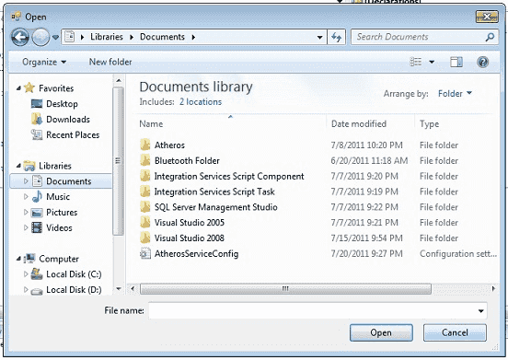

Slide 4
Add Button in form and write code
private void button1_Click(object sender, EventArgs e) {
OpenFileDialog op = new OpenFileDialog();
op.ShowDialog();
if (op.ShowDialog() == DialogResult.OK)
{
String filename = op.FileName;
MessageBox.Show(filename);
}
}

Slide 5

KeyPress Event
Windows Forms processes keyboard input by raising keyboard events in response to Windows messages.
Most Windows Forms applications process keyboard input exclusively by handling the keyboard events.

Slide 6
You can detect most physical key presses by handling the KeyDown or KeyUp events.
Key events occur in the following order:
KeyDown
KeyPress
KeyUp

Slide 7
How to get TextBox1_KeyDown event
Select your TextBox control on your Form and go to Properties window.
Select Event icon on the properties window and scroll down and find the KeyDown event from the list and double click the Keydown Event.
Then you will get the KeyDown event in your source code editor.
private void textBox1_KeyDown(.....)
{
}

Slide 8
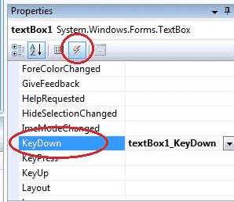

Slide 9
KeyDown Event : This event raised as soon as the user presses a key on the keyboard, it repeats while the user keeps the key depressed.
KeyPress Event : This event is raised for character keys while the key is pressed and then released. This event is not raised by noncharacter keys, unlike KeyDown and KeyUp, which are also raised for noncharacter keys
KeyUp Event : This event is raised after the user releases a key on the keyboard.

Slide 10
private void textBox1_KeyPress(object sender, KeyPressEventArgs e) {
if (e.KeyChar == (char)Keys.Enter) {
MessageBox.Show("Enter key pressed"); }
if (e.KeyChar == 13) {
MessageBox.Show("Enter key pressed"); }
}

Slide 11
MDI Form
A Multiple Document Interface (MDI) programs can display multiple child windows inside them.
This is in contrast to single document interface (SDI) applications, which can manipulate only one document at a time.
Visual Studio Environment is an example of Multiple Document Interface (MDI) and notepad is an example of an SDI application.
MDI applications often have a Window menu item with submenus for switching between windows or documents.

Slide 12
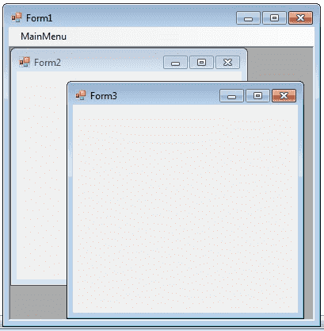

Slide 13
Any windows can become an MDI parent, if you set the IsMdiContainer property to True.
IsMdiContainer = true;
The following C# program shows a MDI form with two child forms.
Create a new C# project, then you will get a default form Form1 .
Then add two more forms in the project (Form2 , Form 3) .
Create a Menu on your form and call these two forms on menu click event.
Click here to see how to create a Menu on your form How to Menu Control C#.

Slide 14
In Click Event of Menu Items Add
private void form1ToolStripMenuItem_Click(object sender, EventArgs e) {
Form3 f3 = new Form3();
f3.Show();
f3.MdiParent = this;
f3.Dock = DockStyle.Fill; }
private void toolStripMenuItem2_Click(object sender, EventArgs e) {
form4 f4 = new form4();
f4.Show();
f4.MdiParent = this;
}

